Slide 1
One Size Still Doesn’t Fit All— Amara Graham Developer Advocate @MissAmaraKay

Slide 2
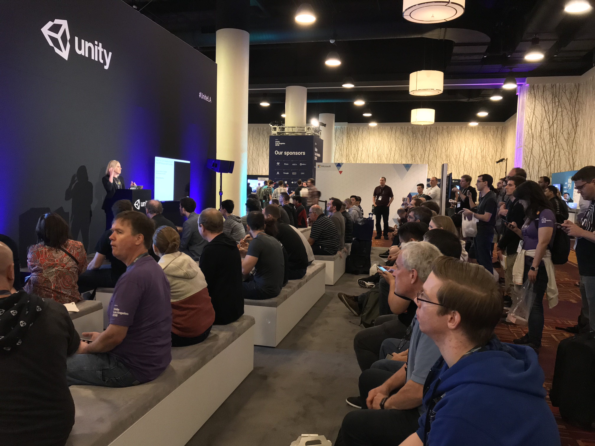

Slide 3
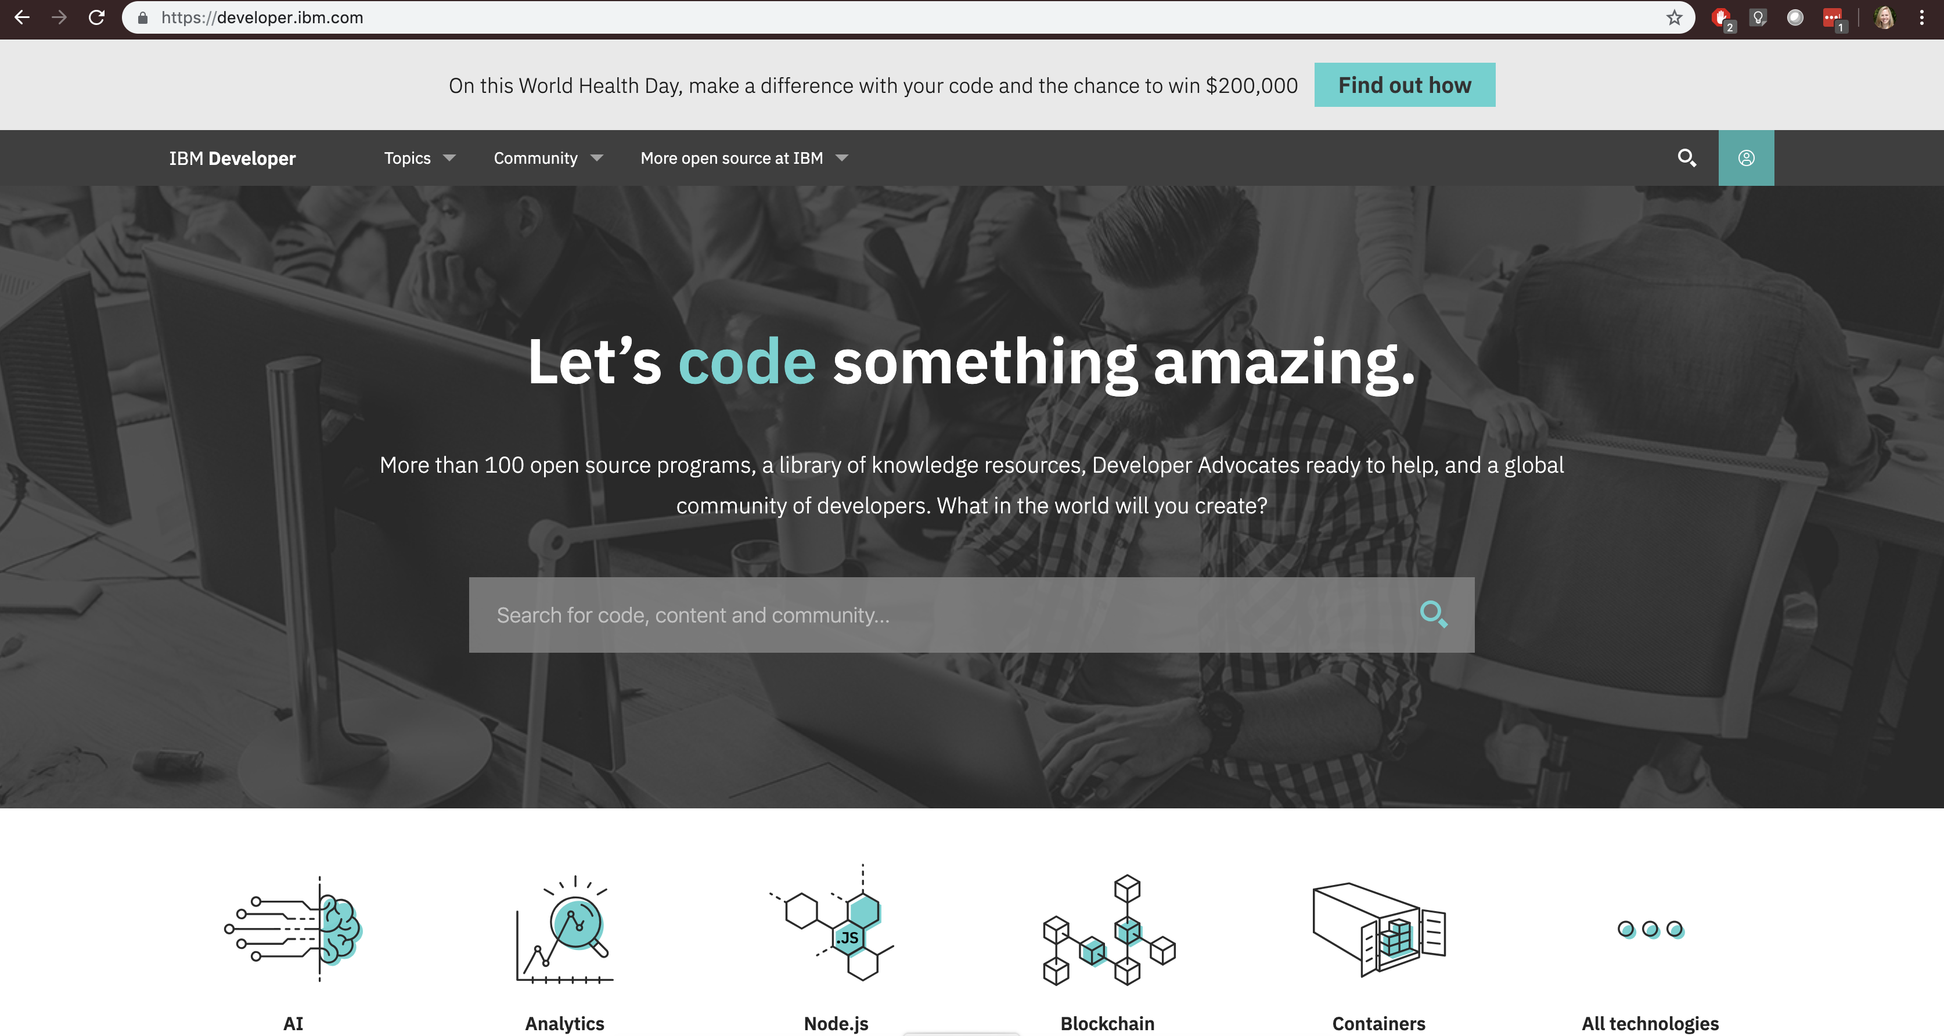

Slide 4

Quick thought exercise.
Notes:
Here is the interactive piece, so I hope the coffee has kicked in by now.
You might not be in the exact same boat as I am, but maybe you can extract some goodness to apply to your own situation.
But let’s think about some things that might apply to creation of personas.

Slide 5

”What is an enterprise developer?”
Mid-large company
Sit in an IT or software services group
Probably co-located
Working in an “agile” team
Comfortable with acronyms
Specific tech stack or domain specific role
Integrations with Salesforce & SAP
Doing something with open source
Access to training (online, classroom, books, etc.)
Budget > $0
This is their day job.
Notes:
I could have easily filled this slide with tons of generalizations. And I did, because all of this was my reality when I started my career as an enterprise web developer.
But the truth is, an enterprise developer is going to be well supported, budgeted, and incentivized to make things work. No one goes home and is an enterprise developer in their spare time.
We can also make some assumptions given their current tech stack, skillset, products, etc.

Slide 6

“What is a game developer?”
Fluid definition – indie vs. AAA (everything in between)
Designers and artists often don’t consider themselves technical
Variety of skills at varying levels
Variety of time commitment (at varying levels)
May see teammates at game jams or only online
Read all the T&Cs for each game engine before picking which one would take the least of their money
Work on teams of one to many
Role might be specific to current game title or project
Questionable budget
This may be their day job, second job, hobby, passion project.
Notes:
We might be able to make some assumptions about the kinds of games they want to build – battle royale?

Slide 7


”Nights and weekend" developers
Notes:
Unity conversation around a docs & tutorial strategy.
So if I want to help enable AI developers in the game dev space, I need to take this into consideration.
Plant this seed in the back of your mind for later.

Slide 8
Amara’s Game Dev Considerations
Device/Hardware (mobile, console, PC)
IBM Cloud/Watson needs “always connected”
(IBM Cloud Private, just for Assistant)
Game Engine
Programming language
Attention Span & Quality of Attention
Chunk up how-tos
Can be a series
Time estimates*
Level indicator (beginner, intermediate, advanced)*
Video vs. written
Anything for cost needs to be explicit
Audit existing material (enterprise focus)
…
Notes:
I need to get better about some of these personally.
These were not the folks that were going to respond the same way as our “traditional” audience, we can’t just have them hack on our API with a brief intro.

Slide 9
“Enterprise Developers”
Highly technical (developers)
Artists & Designers
(y’all are technical, believe me!)
Hobbyists
Scaling with Kubernetes
Using Watson SDK for Unity
Using CoreML + Watson Visual Recognition
Overview of AI Services & ML/DL
Getting Started with the Watson SDK for Unity
Overview of AI Services
Getting Started with the Watson SDK for Unity
Overview of AI Services
All of our existing content
Notes:
My brain thinks in lists and buckets if you haven’t already realized that. So to take some of the chaos happening in my brain and get it out on “paper” here’s what that kind of looks like.
Started thinking of natural buckets for things, rather than calling them personas. I wanted to reuse or repurpose existing material.

Slide 10
But what we actually needed…

Slide 11
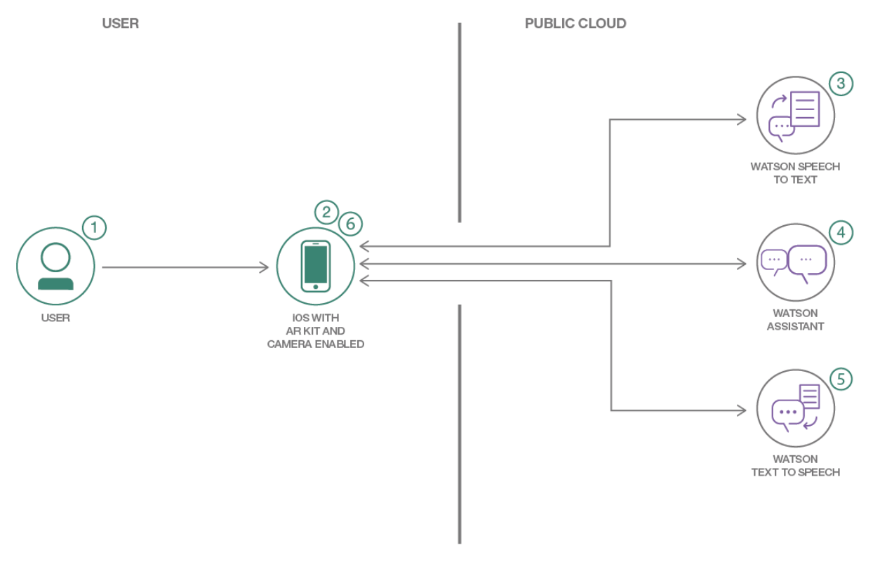
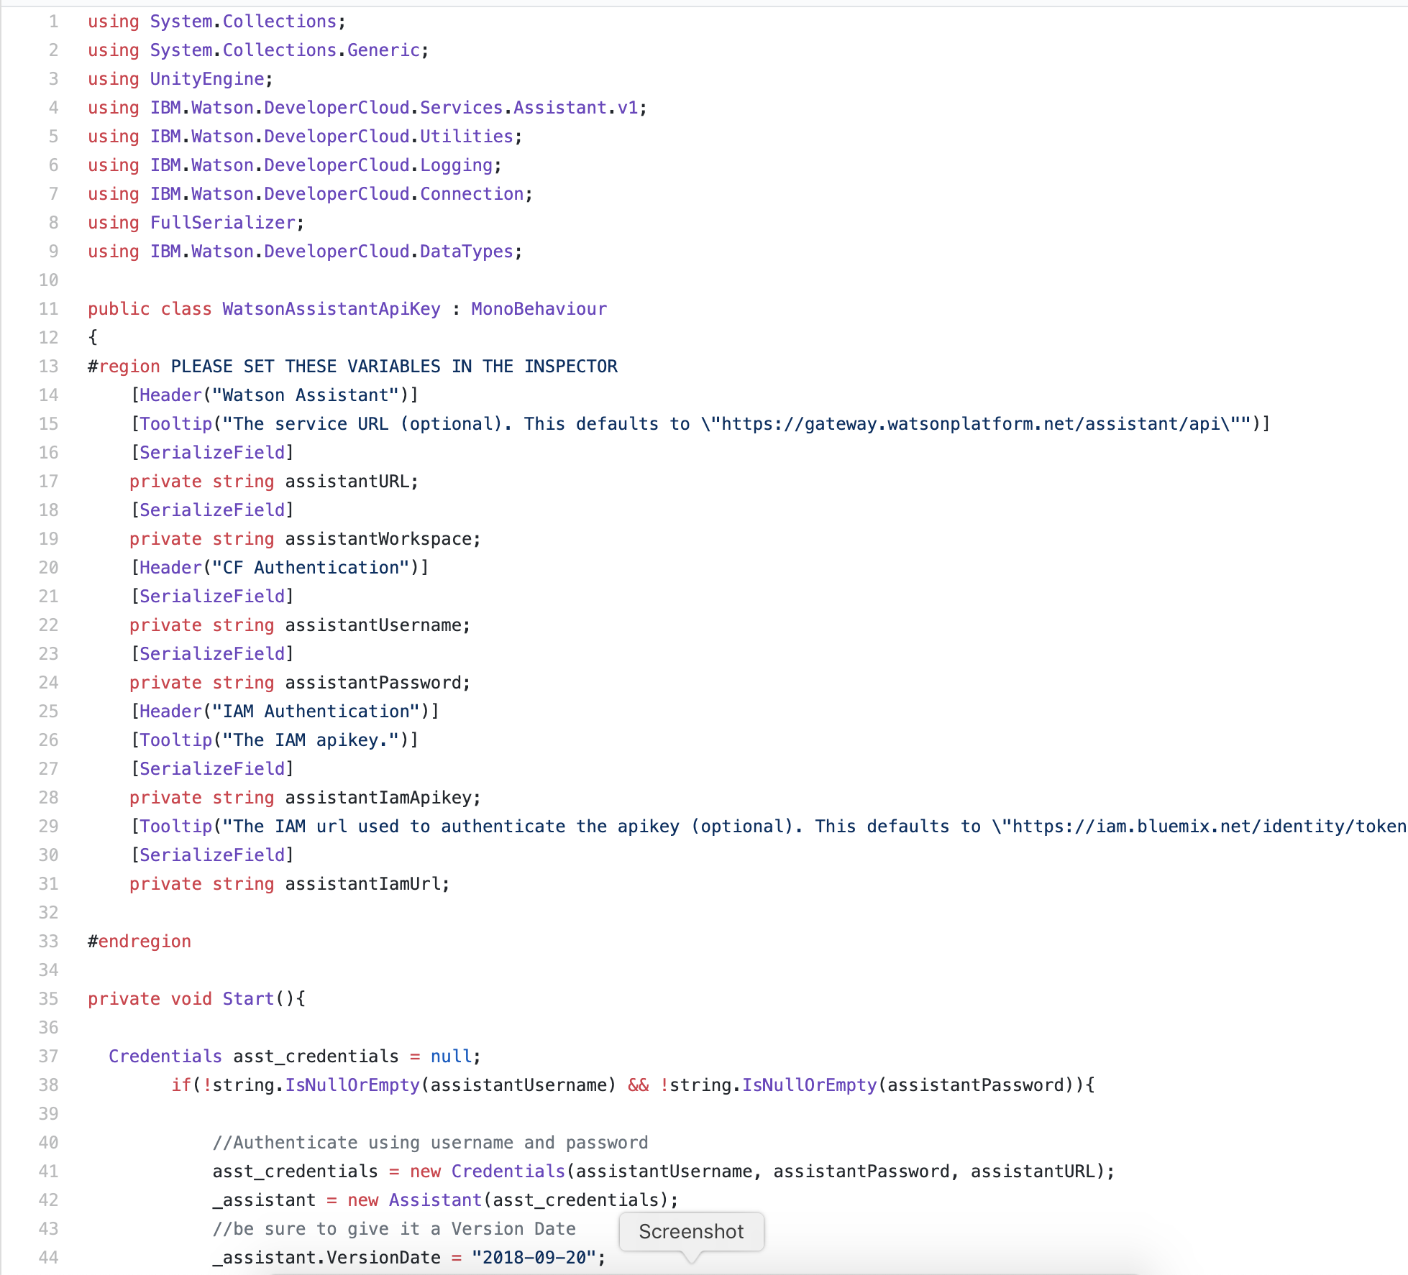
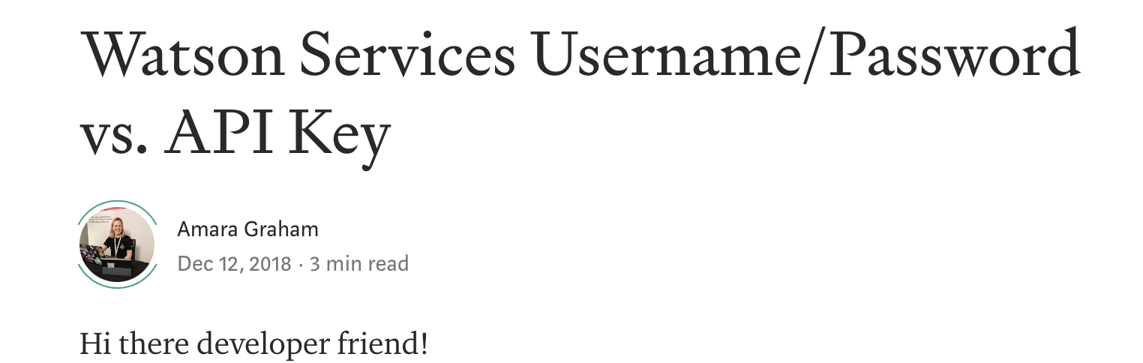
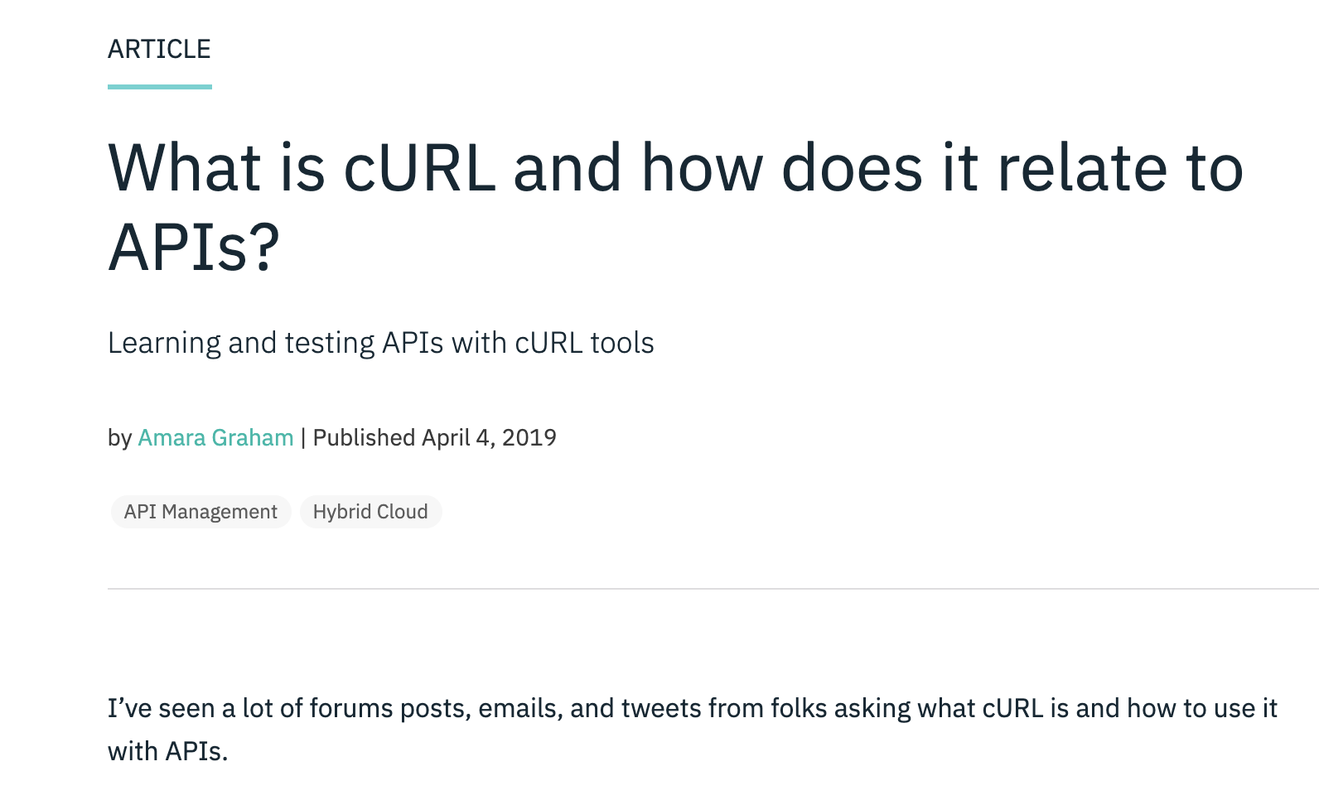
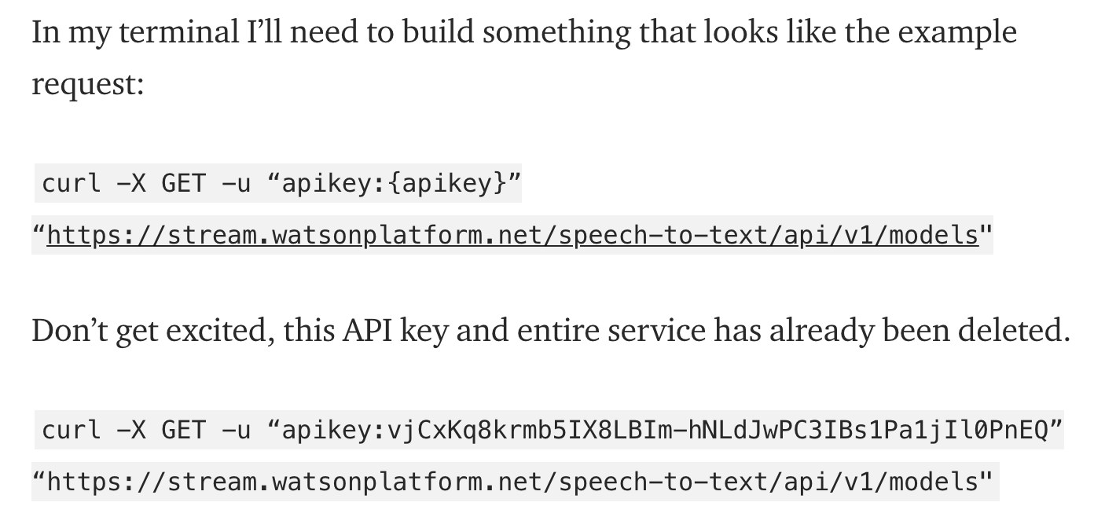

Slide 12

Shameless Plug!
IBM Cloud Account
ibm.biz/DevRelConSF19
Code Pattern
ibm.biz/AvatarPattern

Slide 13
Things to Think About
Who is using your docs today? Are they getting what they need?
Are you agile? Consider adjusting your personas too.
Did you cover the basics? Are you sure?
Did you make assumptions that could alienate groups?

Slide 14

Thank You!
Amara Graham
Developer Advocate
—
@MissAmaraKay

